Slide 1
7th July
The story of UAV which want to live
Východná, Slovakia
Alojz Gomola, Advanced Technology Europe
Notes:
Good morning/afternoon,
Today I will be presenting progress report at Probabilistic approach in Obstacle avoidance

Slide 2
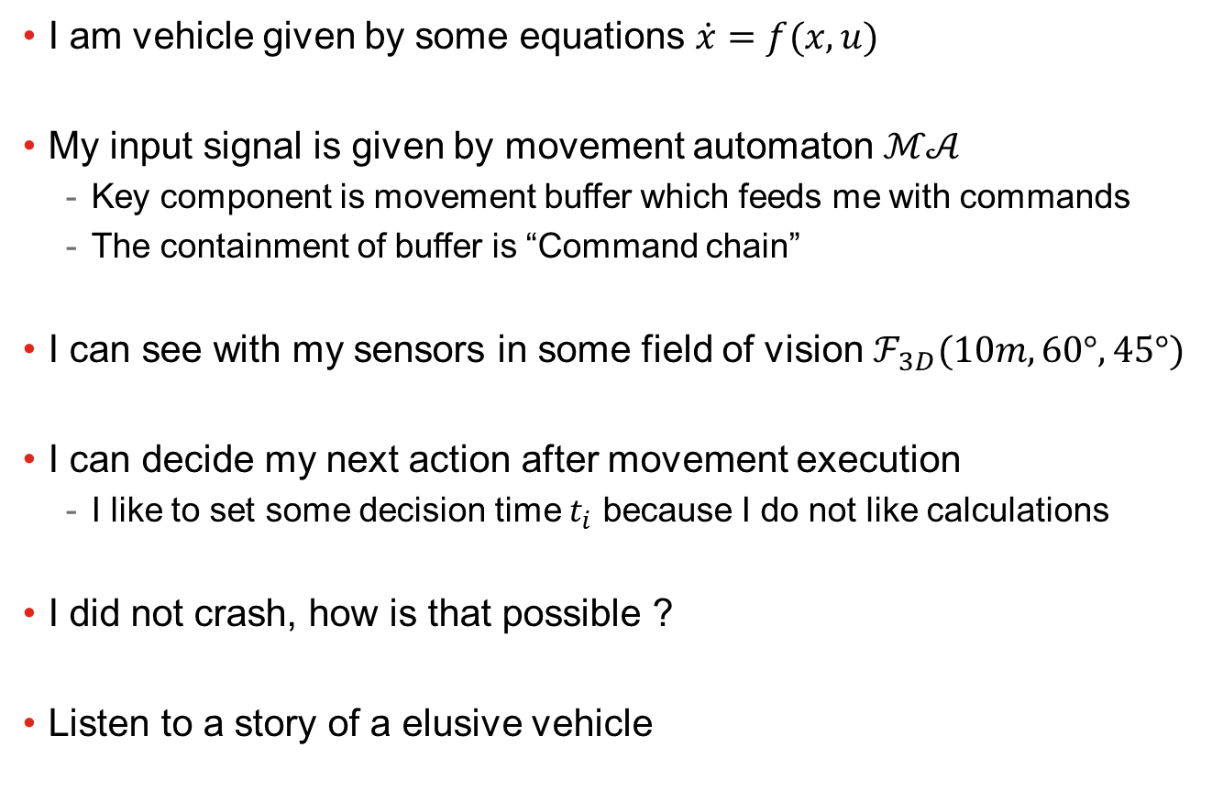
I have a mission and I don’t want to crash
I am vehicle given by some equations $\dot{x}=f(x,u)$
My input signal is given by movement automaton $ℳ𝒜$
Key component is movement buffer which feeds me with commands
The containment of buffer is “Command chain”
I can see with my sensors in some field of vision $ℱ_{3D}(10m,60°,45°)$
I can decide my next action after movement execution
I like to set some decision time $t_{i}$ because I do not like calculations
I did not crash, how is that possible ?
Listen to a story of a elusive vehicle

Slide 3
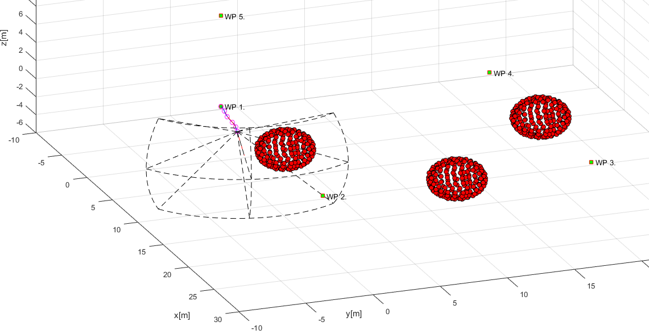
This is my mission
I don’t see this
I see what is here
Start WP
I see this
Path
My Goal

Slide 4
This is my decision logic
Where I must go
LiDAR
Mission Plan
My Eyes
Avoidance grid
Making decisions
Where I can go
Movement Automaton
Reach set estimation
Controls me
Notes:
Reachable and unreachable space is assessed in grid

Slide 5
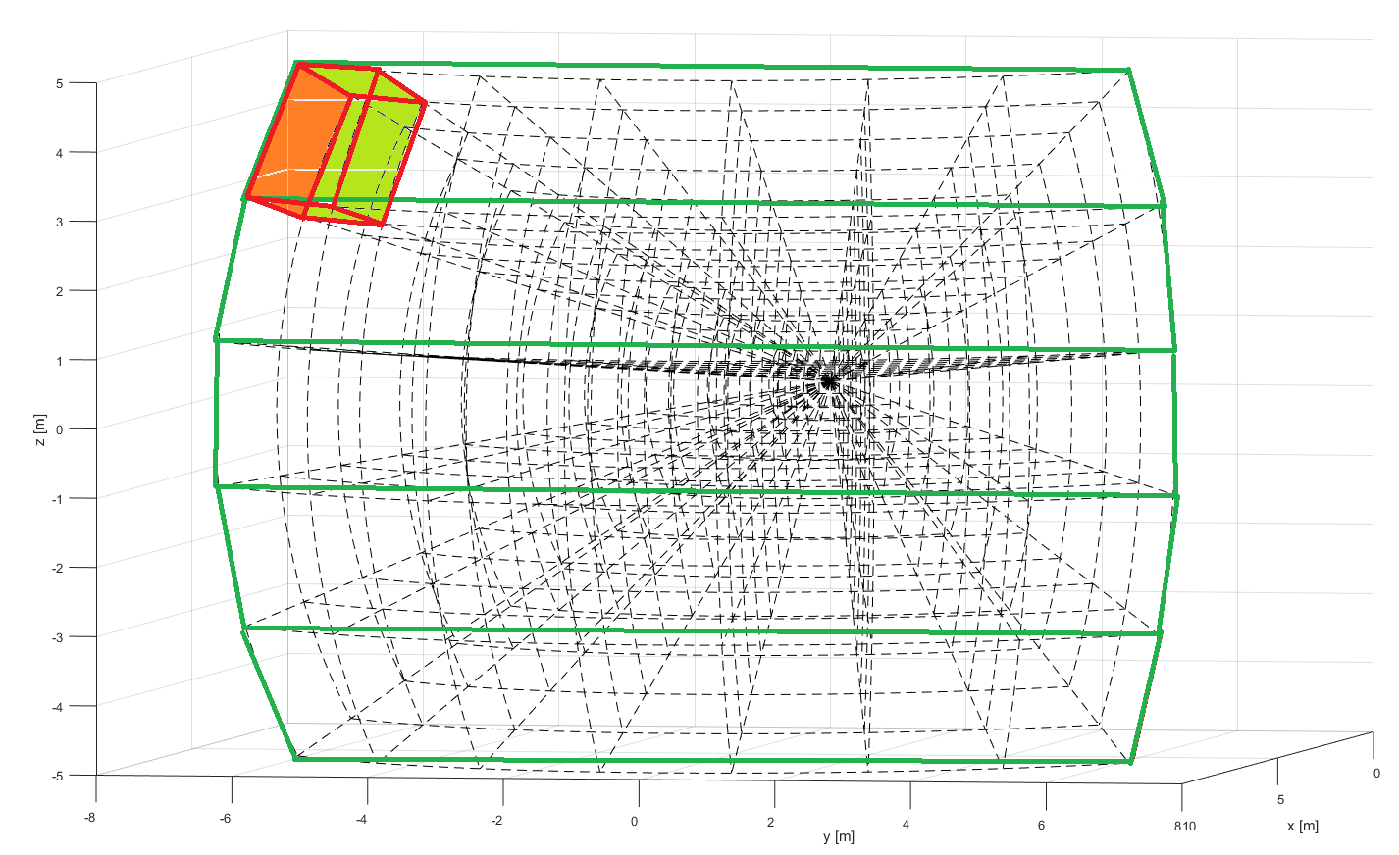
How I see world (Avoidance grid)
Layers
Cell (10,1,1)
Top
Top-Middle
Horizontal layers
Here I am
Middle
Bottom-middle
Bottom

Slide 6
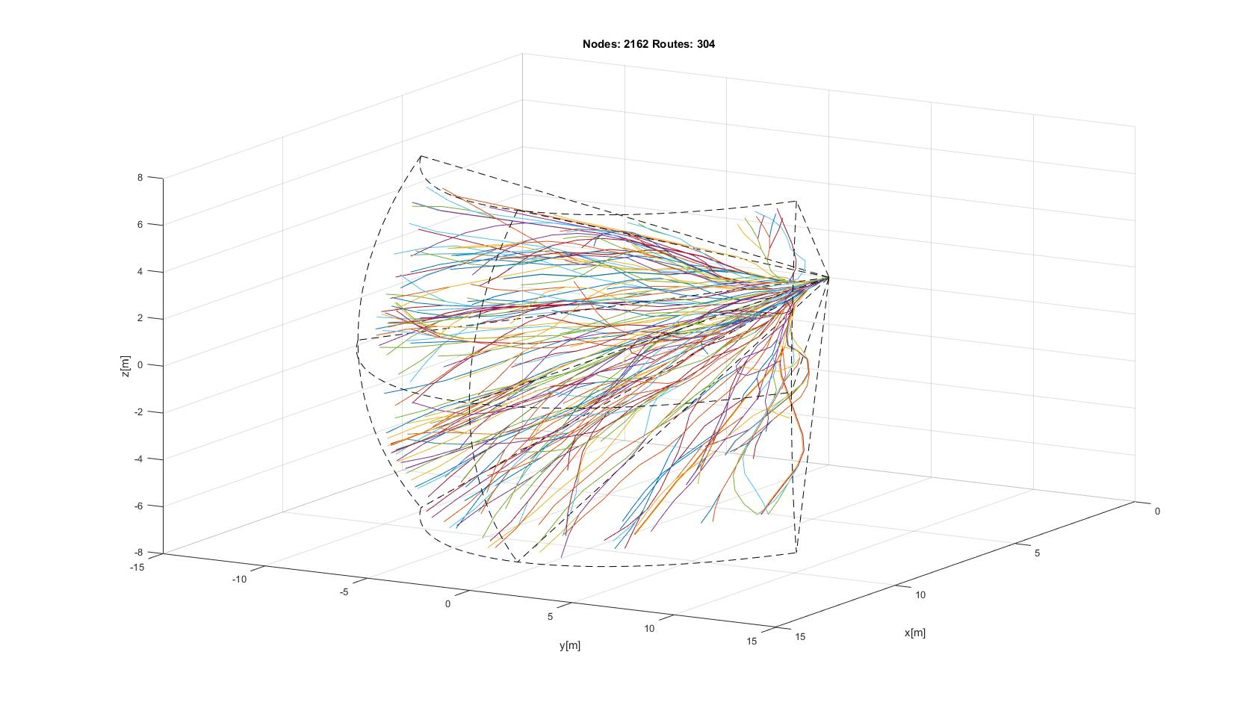
Where I can fly in my FOV (My reach set)
Notes:
Combined or Harmonic spread contains some chaotic routes and guarantees direct and smooth lines in grid

Slide 7
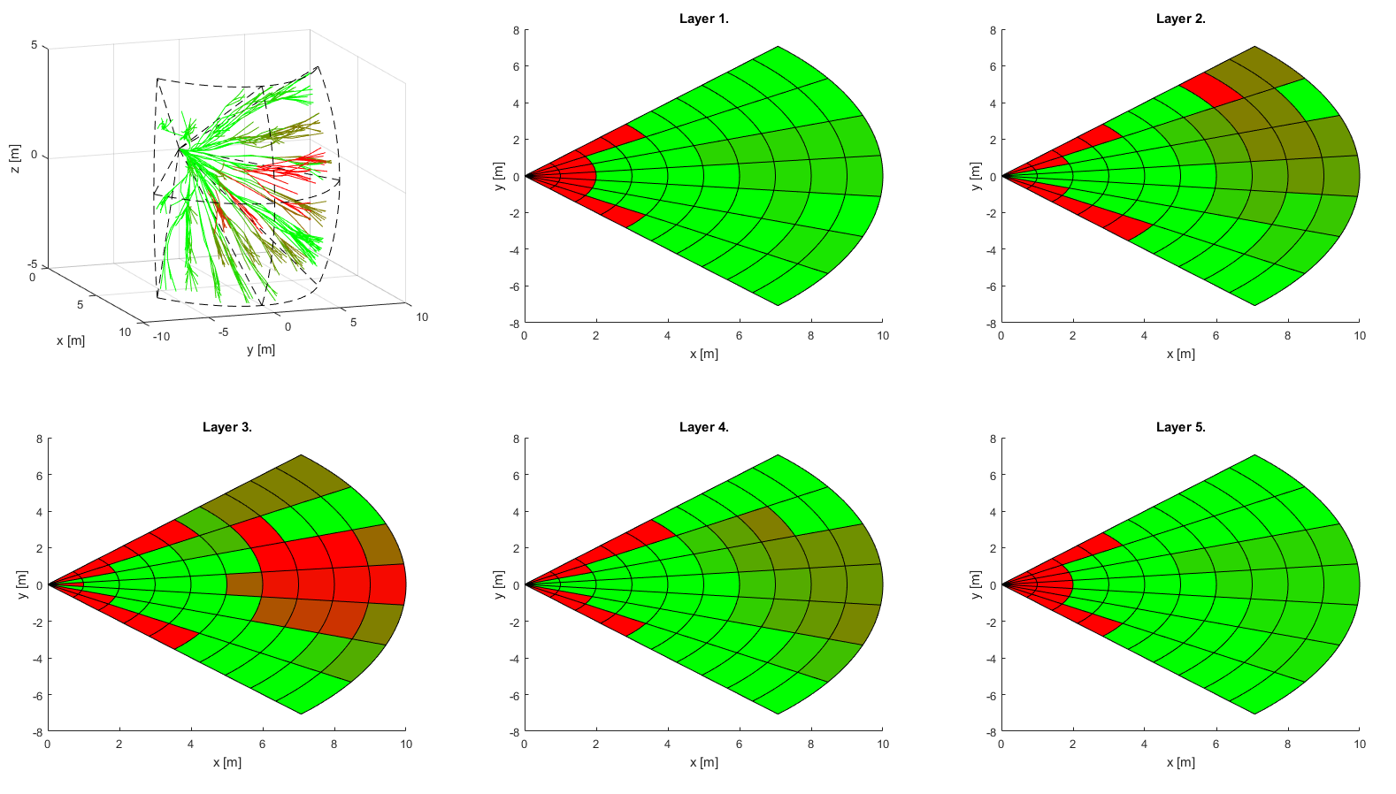
How I change my reach set
Reachable
Unreachable
Hindered

Slide 8
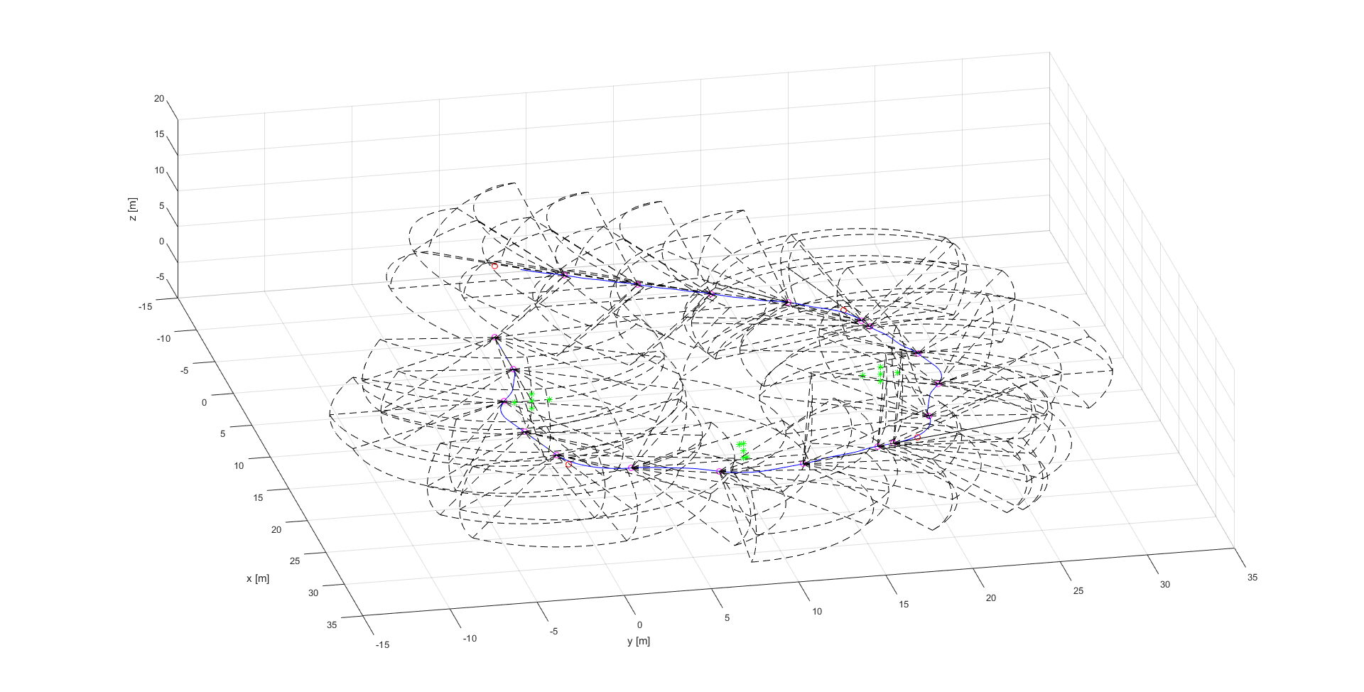
When I make decisions
Join multiple avoidance grids

Slide 9
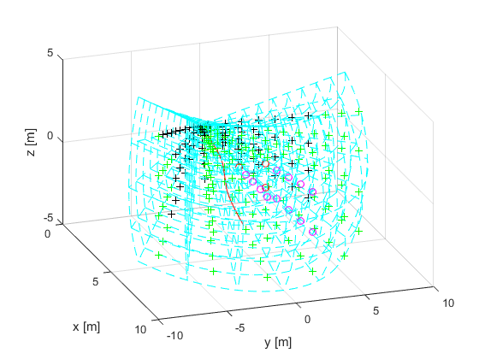
How I represent my world
I am here

Slide 10
How I represent my world
Avoidance trajectorty

Slide 11
How I represent my world
Reachable cell

Slide 12
How I represent my world
Unreachable cell

Slide 13
How I represent my world
Obstacle cell

Slide 14
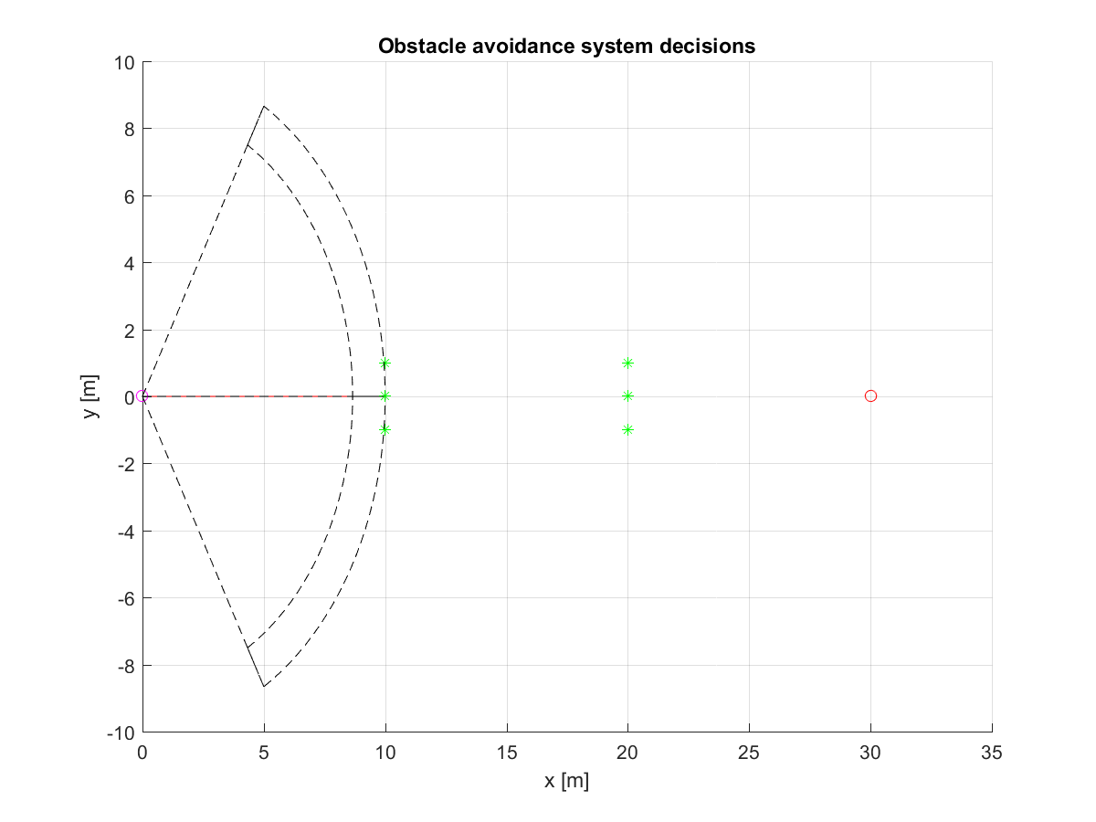
How I join multiple avoidance grids (1)
Avoidance grid A(t1)
My position
Obstacle
Obstacle
My goal

Slide 15
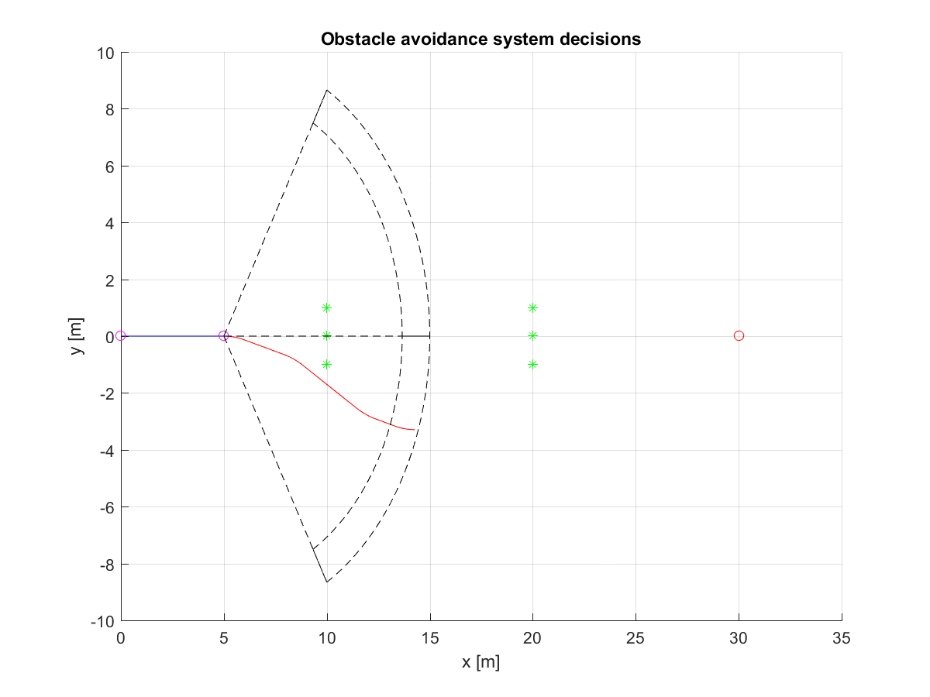
How I join multiple avoidance grids (2)
Avoidance grid A(t2)
I flew this
I plan this
I make me next ecision here

Slide 16
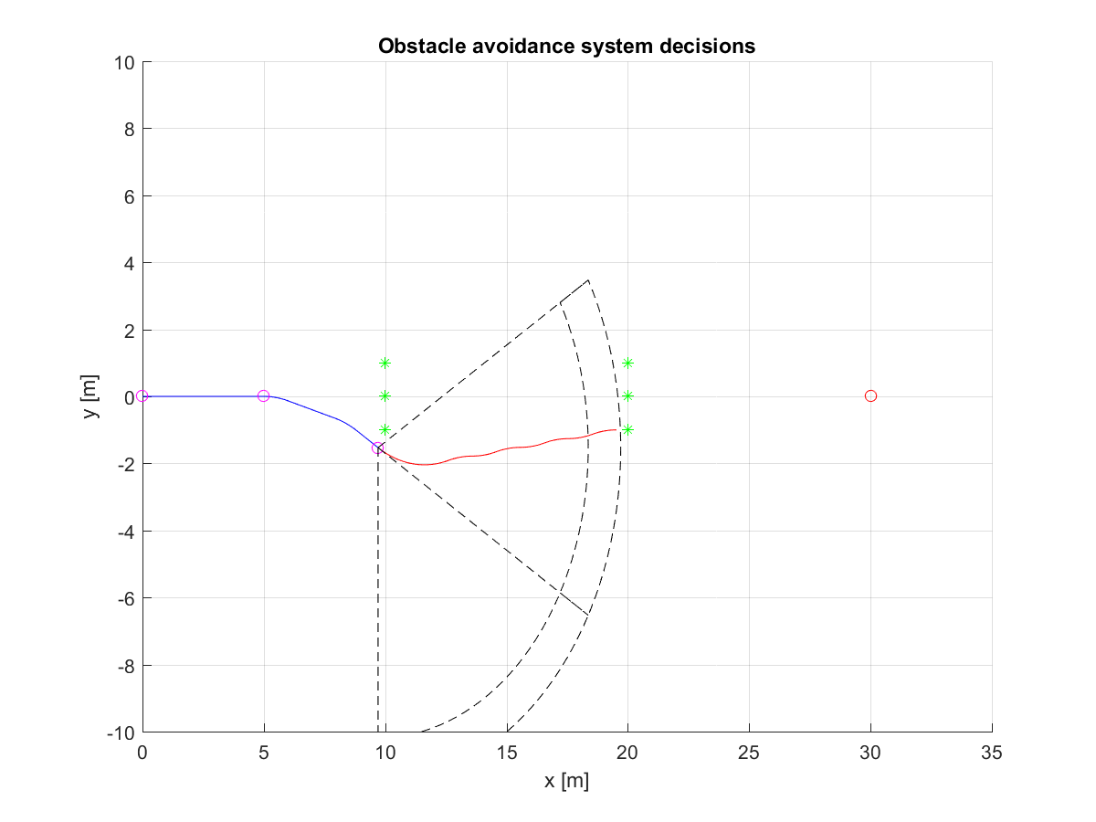
How I join multiple avoidance grids (3)
Avoidance grid A(t3)
I make me next ecision here

Slide 17
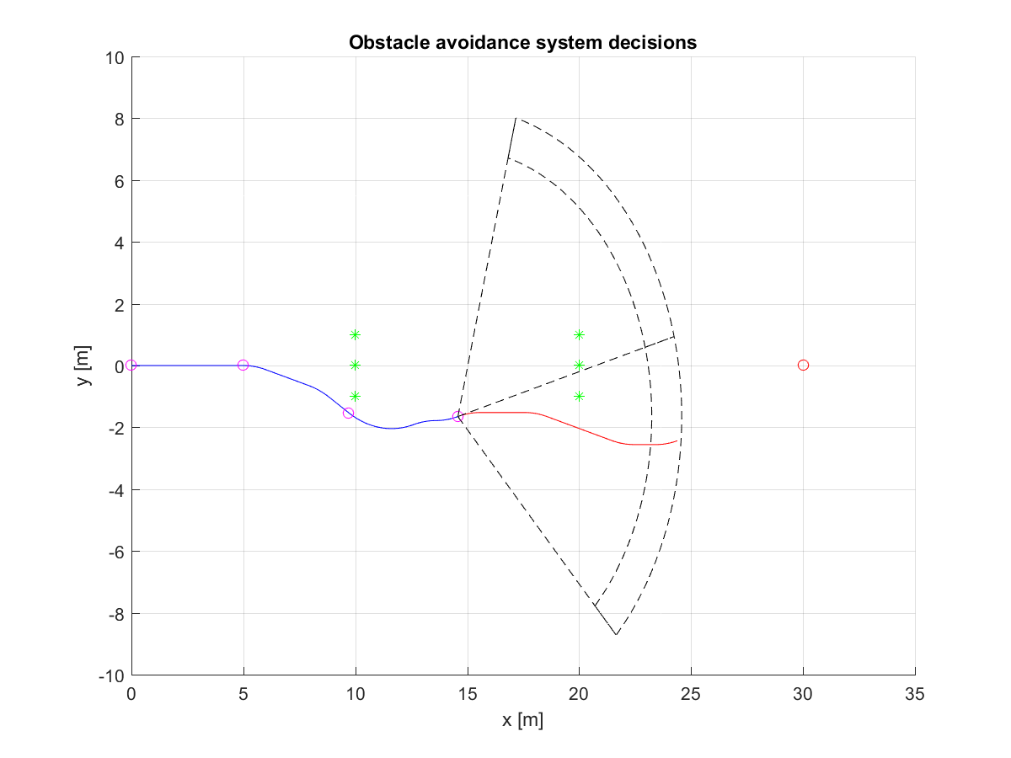
How I join multiple avoidance grids (4)
Avoidance grid A(t4)
I make me next ecision here

Slide 18
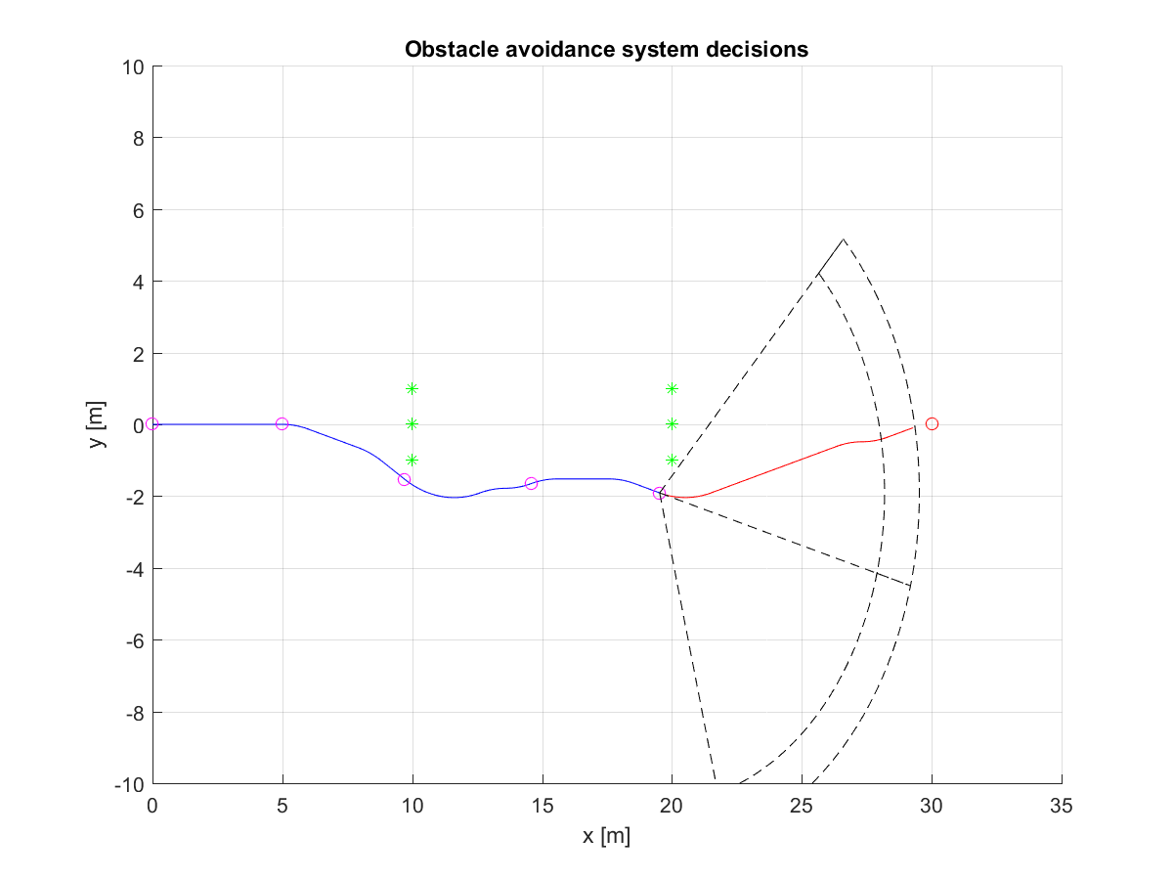
How I join multiple avoidance grids (5)
Avoidance grid A(t5)
I make me next ecision here

Slide 19
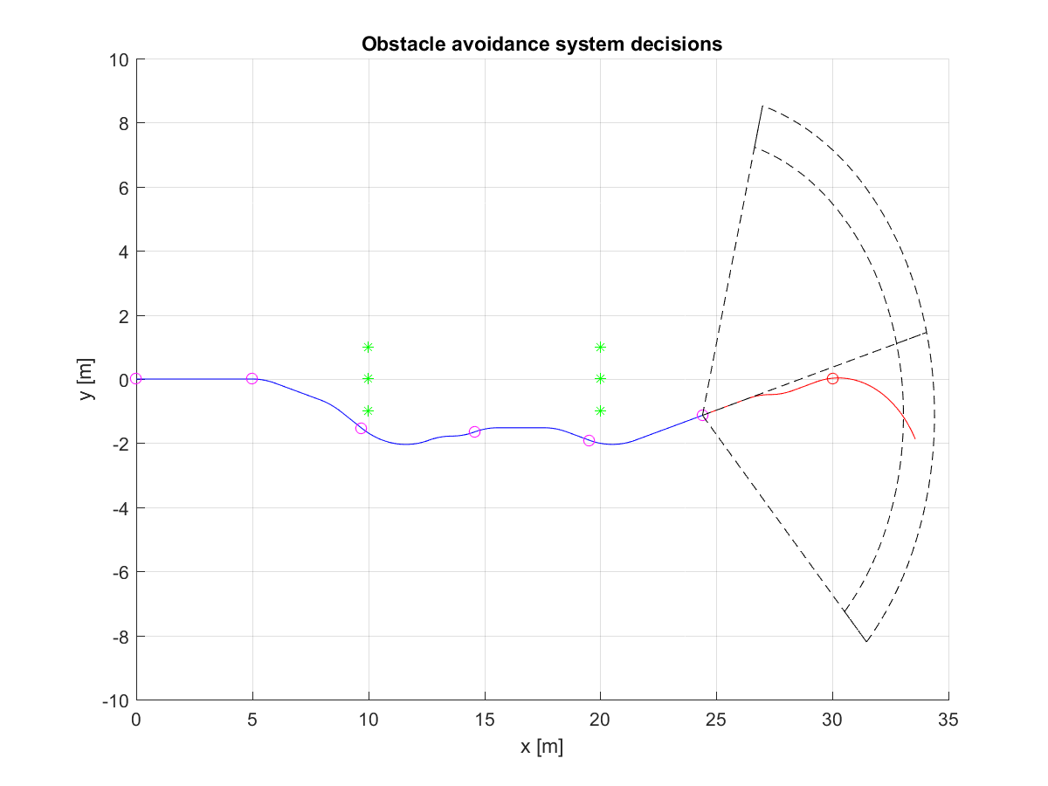
How I join multiple avoidance grids (6)
Avoidance grid A(t6)
I make me next ecision here

Slide 20
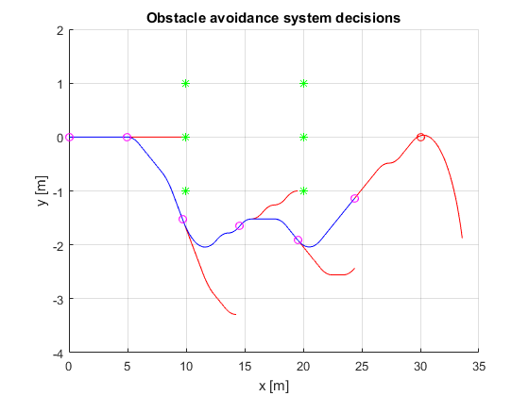
How I avoided obstacles
Decision points
Planned
Executed

